Slide 1
Peds Psychosocial Support
Thursday, October 29, 2015 15:18

Slide 4
**PTSD isn't always the only reaction. BEREAVMENT counseling could be needed as well!!
Coping in light of current stressors can have effects as well!
You aren't only dealing with the stressor that they came in; but what they are already experiencing.
Children in distress do not typically show outright.

Slide 6
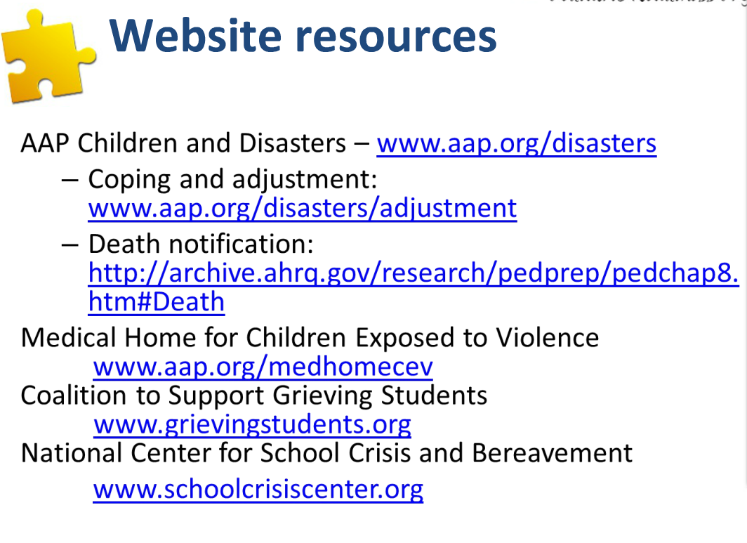

Slide 7
